Slide 1
American History
1
Talk 27: Roaring Twenties (1921-1929)
Part four

Slide 2
Gangsterism ….problems of prohibition

Slide 3
Prohibition
18th Amendment ratified January 16th 1919: alcohol banned January 1st, 1920
Political view “"there is as much chance of repealing the Eighteenth Amendment as there is for a humming-bird to fly to the planet Mars with the Washington Monument tied to its tail."^{[69]}
Religious view: Billy Sunday: “The slums will soon be only a memory. We will turn our prisons into factories and our jails into storehouses and corncribs. Men will walk upright now, women will smile, and the children will laugh. Hell will be forever for rent.”
Initial response
Enthusiastic endorsement/ rise of private clubs “Speakeasies”
Affluent resort to stockpiles, build cellars, secure “medical exemption”
Wealthy Travel to Canada and Cuba ….the poor to Mexico
Enter the criminals

Slide 4
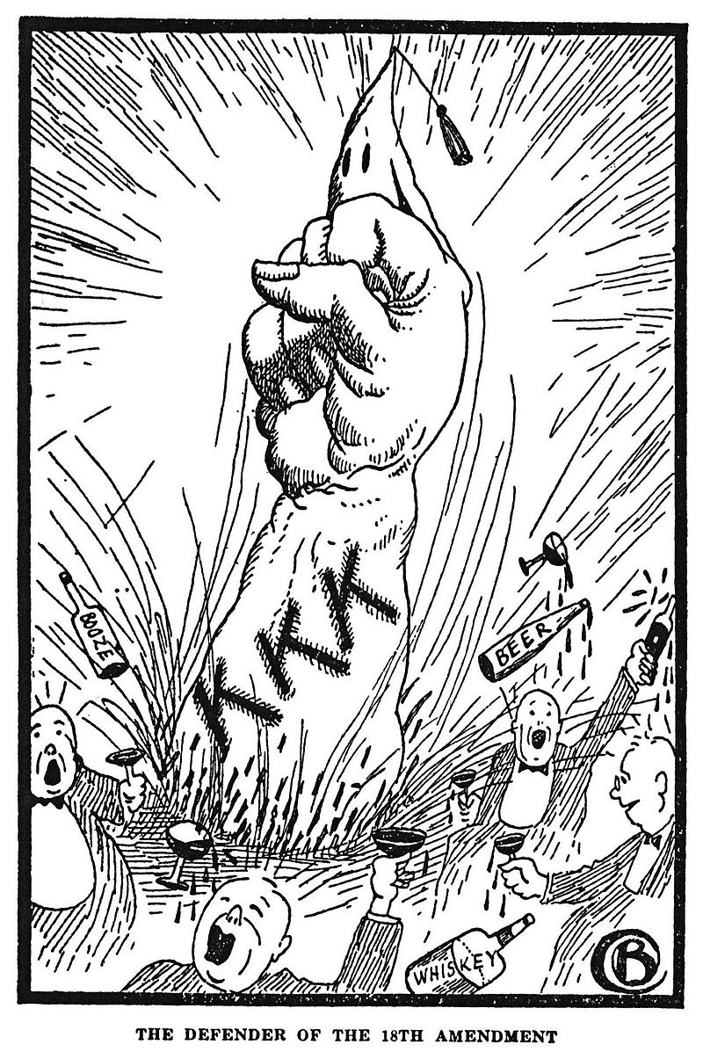
Supporting Prohibition …The “wets” & KKK

Slide 5
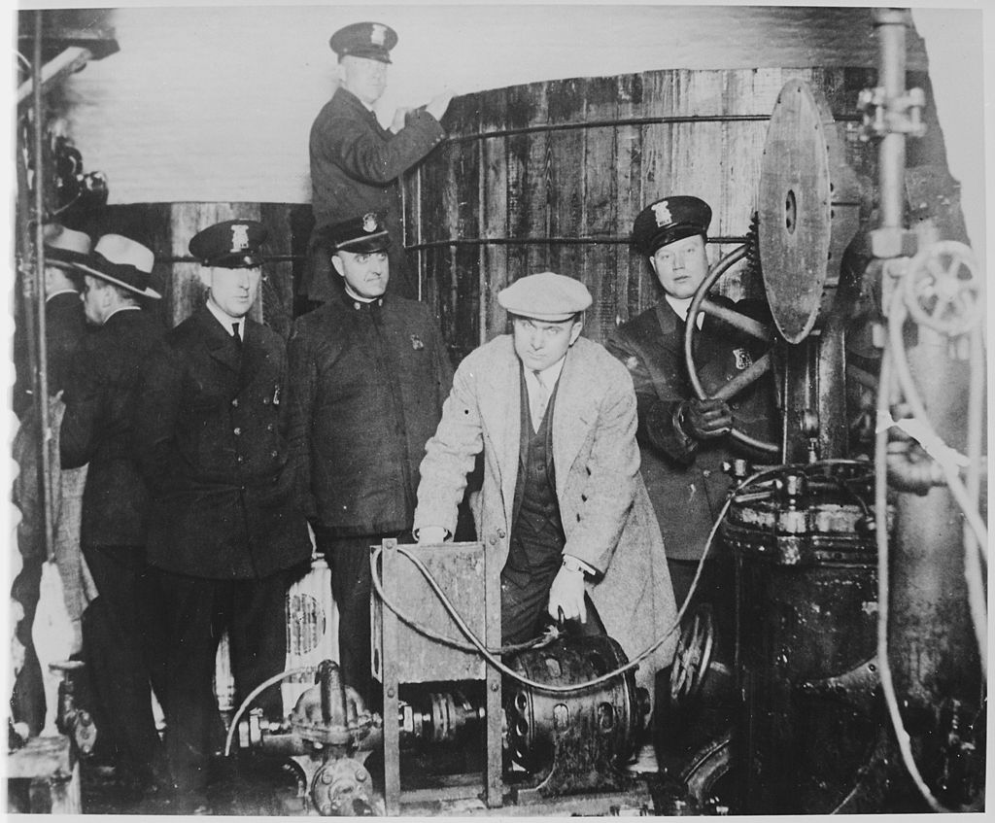
Enforcement enthusiastic….at first

Slide 6
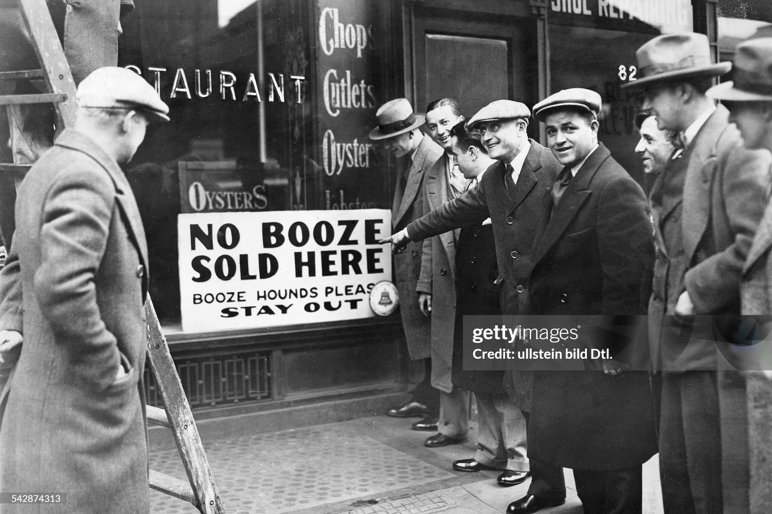
Restaurants comply…..at first

Slide 7
Prohibition impact (1)
Economic
250,000 jobs lost, Restaurants closed…uneconomic
Loss of taxable income (New York lose 75% of State Revenue
“Shadow economy” worth $15BN develops per year (20% of economy)
$300 million spent on enforcement, 3,000 agents, birth of FBI
Health
50% reduction in alcohol consumption …rising to 30% by late 20’s
Shift to spirits /hard liquor…easier to transport
Disastrous experiment to “de-nature” liquor….10,000 poisoned by Govt programme to contaminate stocks

Slide 8
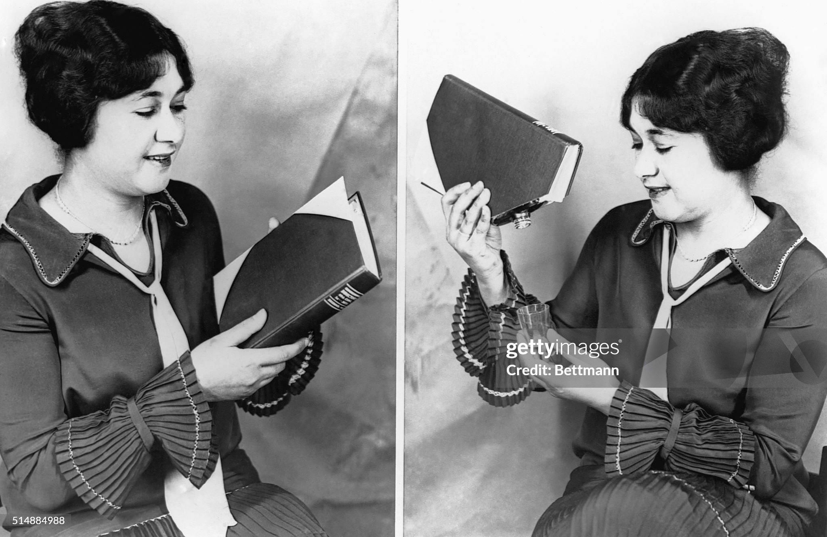
Hiding the booze (illegal to sell and deliver….not to drink!)

Slide 9
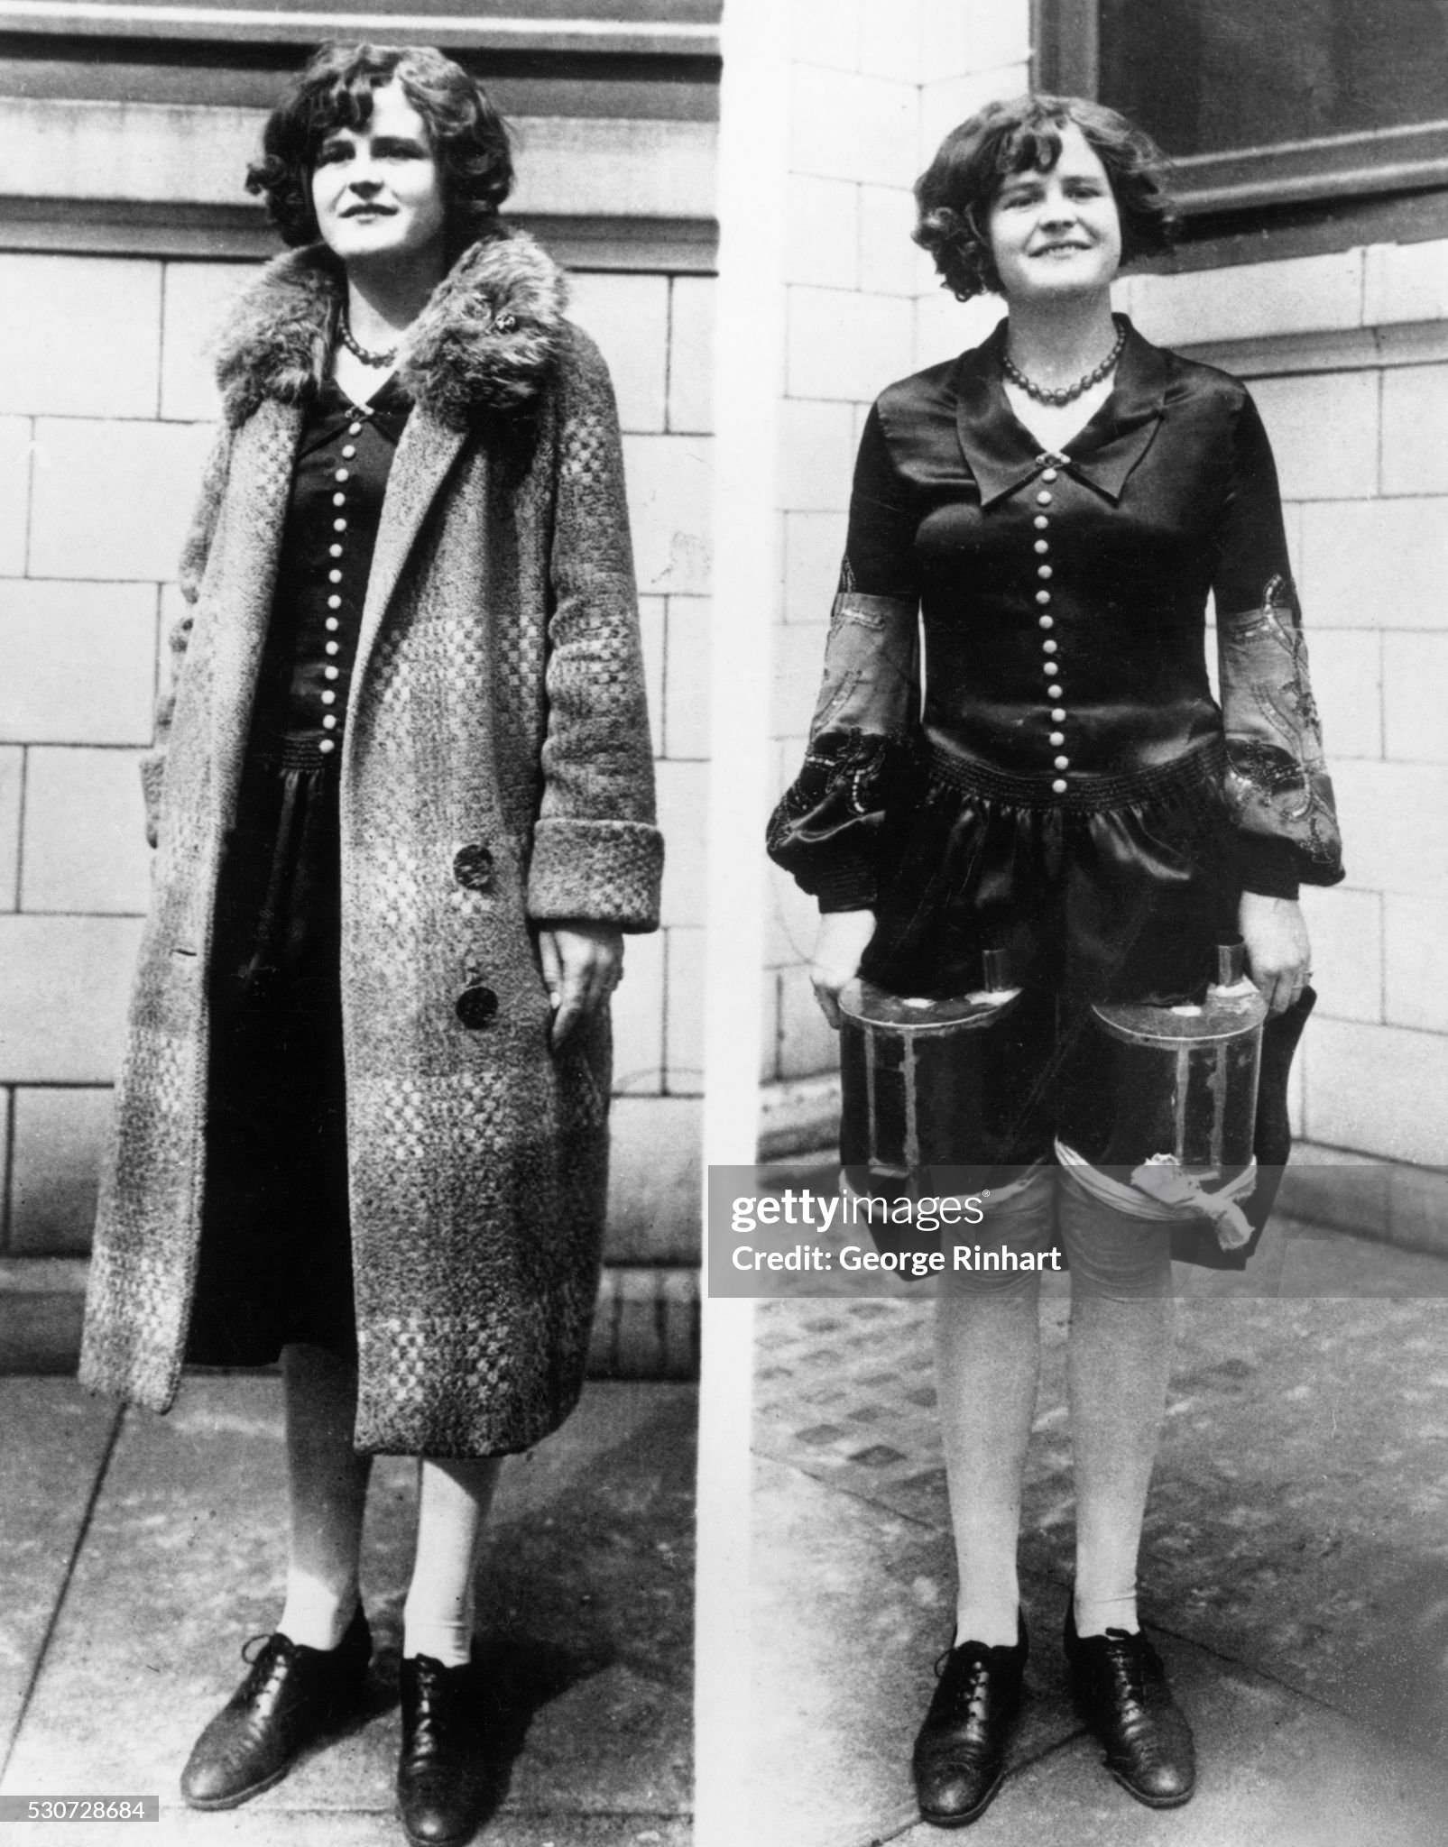

Slide 10
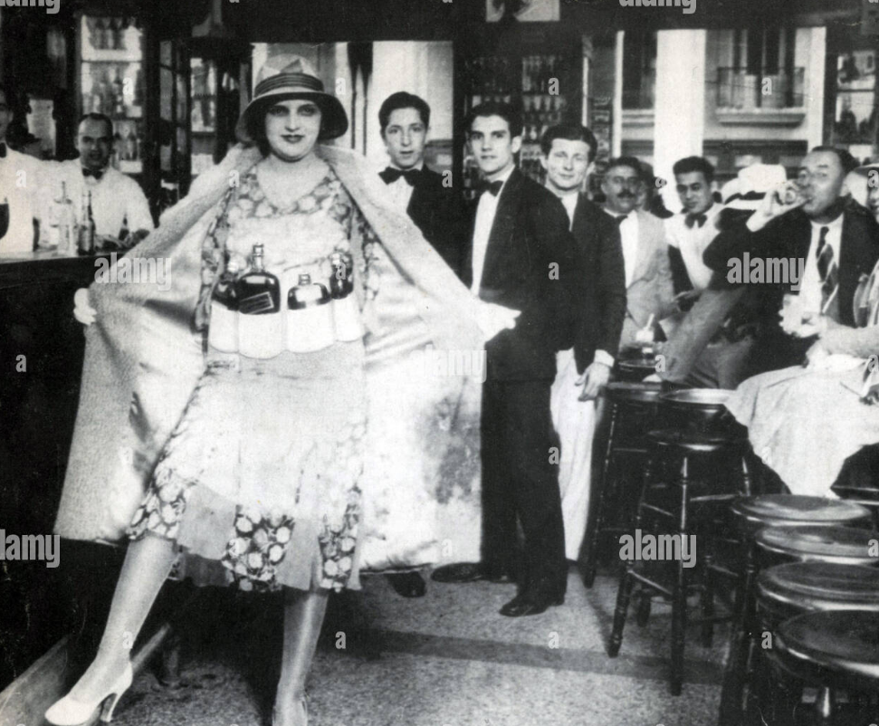
Speakeasies….10,000 in New York by 1926 ……collapse of enforcement

Slide 11
Political/ Social Impact
Conflict Religious, rural, populates vs urban, immigrant communities
Social division
No/light enforcement for wealth
Discrimination vs poor/minorities
Crime
Rise of wealthy and politically powerful crime lords ( Al Capone $1BN+ per year in earnings
“State capture” by crime lords of cities: Chicago, Detroit, Pittsburgh

Slide 12
Invitation to Crime
Italian immigrant community
Closely linked, secret societies
Marginal jobs, self help, brothel, gambling, narcotics
Self enforced, disciplined,
Prohibition opportunity
Cash business
Public complicit/ political influence
Logistics, smuggling Canada, Cuba

Slide 13
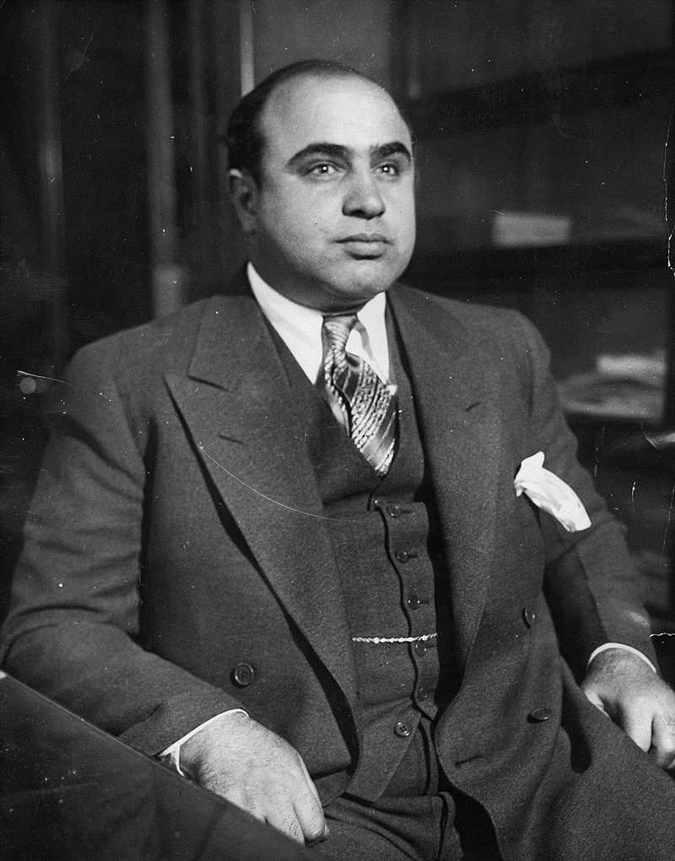
Alphonse Gabriel Capone
Born New York, Italian Immigrants
Gang member, bodyguard, moves to Chicago to work for …bouncer at brothel, promoted by boss
Organises distribution of spirits from Canada, bootlegging’
Responsible for deaths of more than 100 ,rivals across Chicago, personally batters to death 5 captured rivals
Jailed for tax evasion, never found guilty of murder ….dies of syphilis on release from prison due to income tax evasion
E
Al Capone 1899-1947

Slide 14
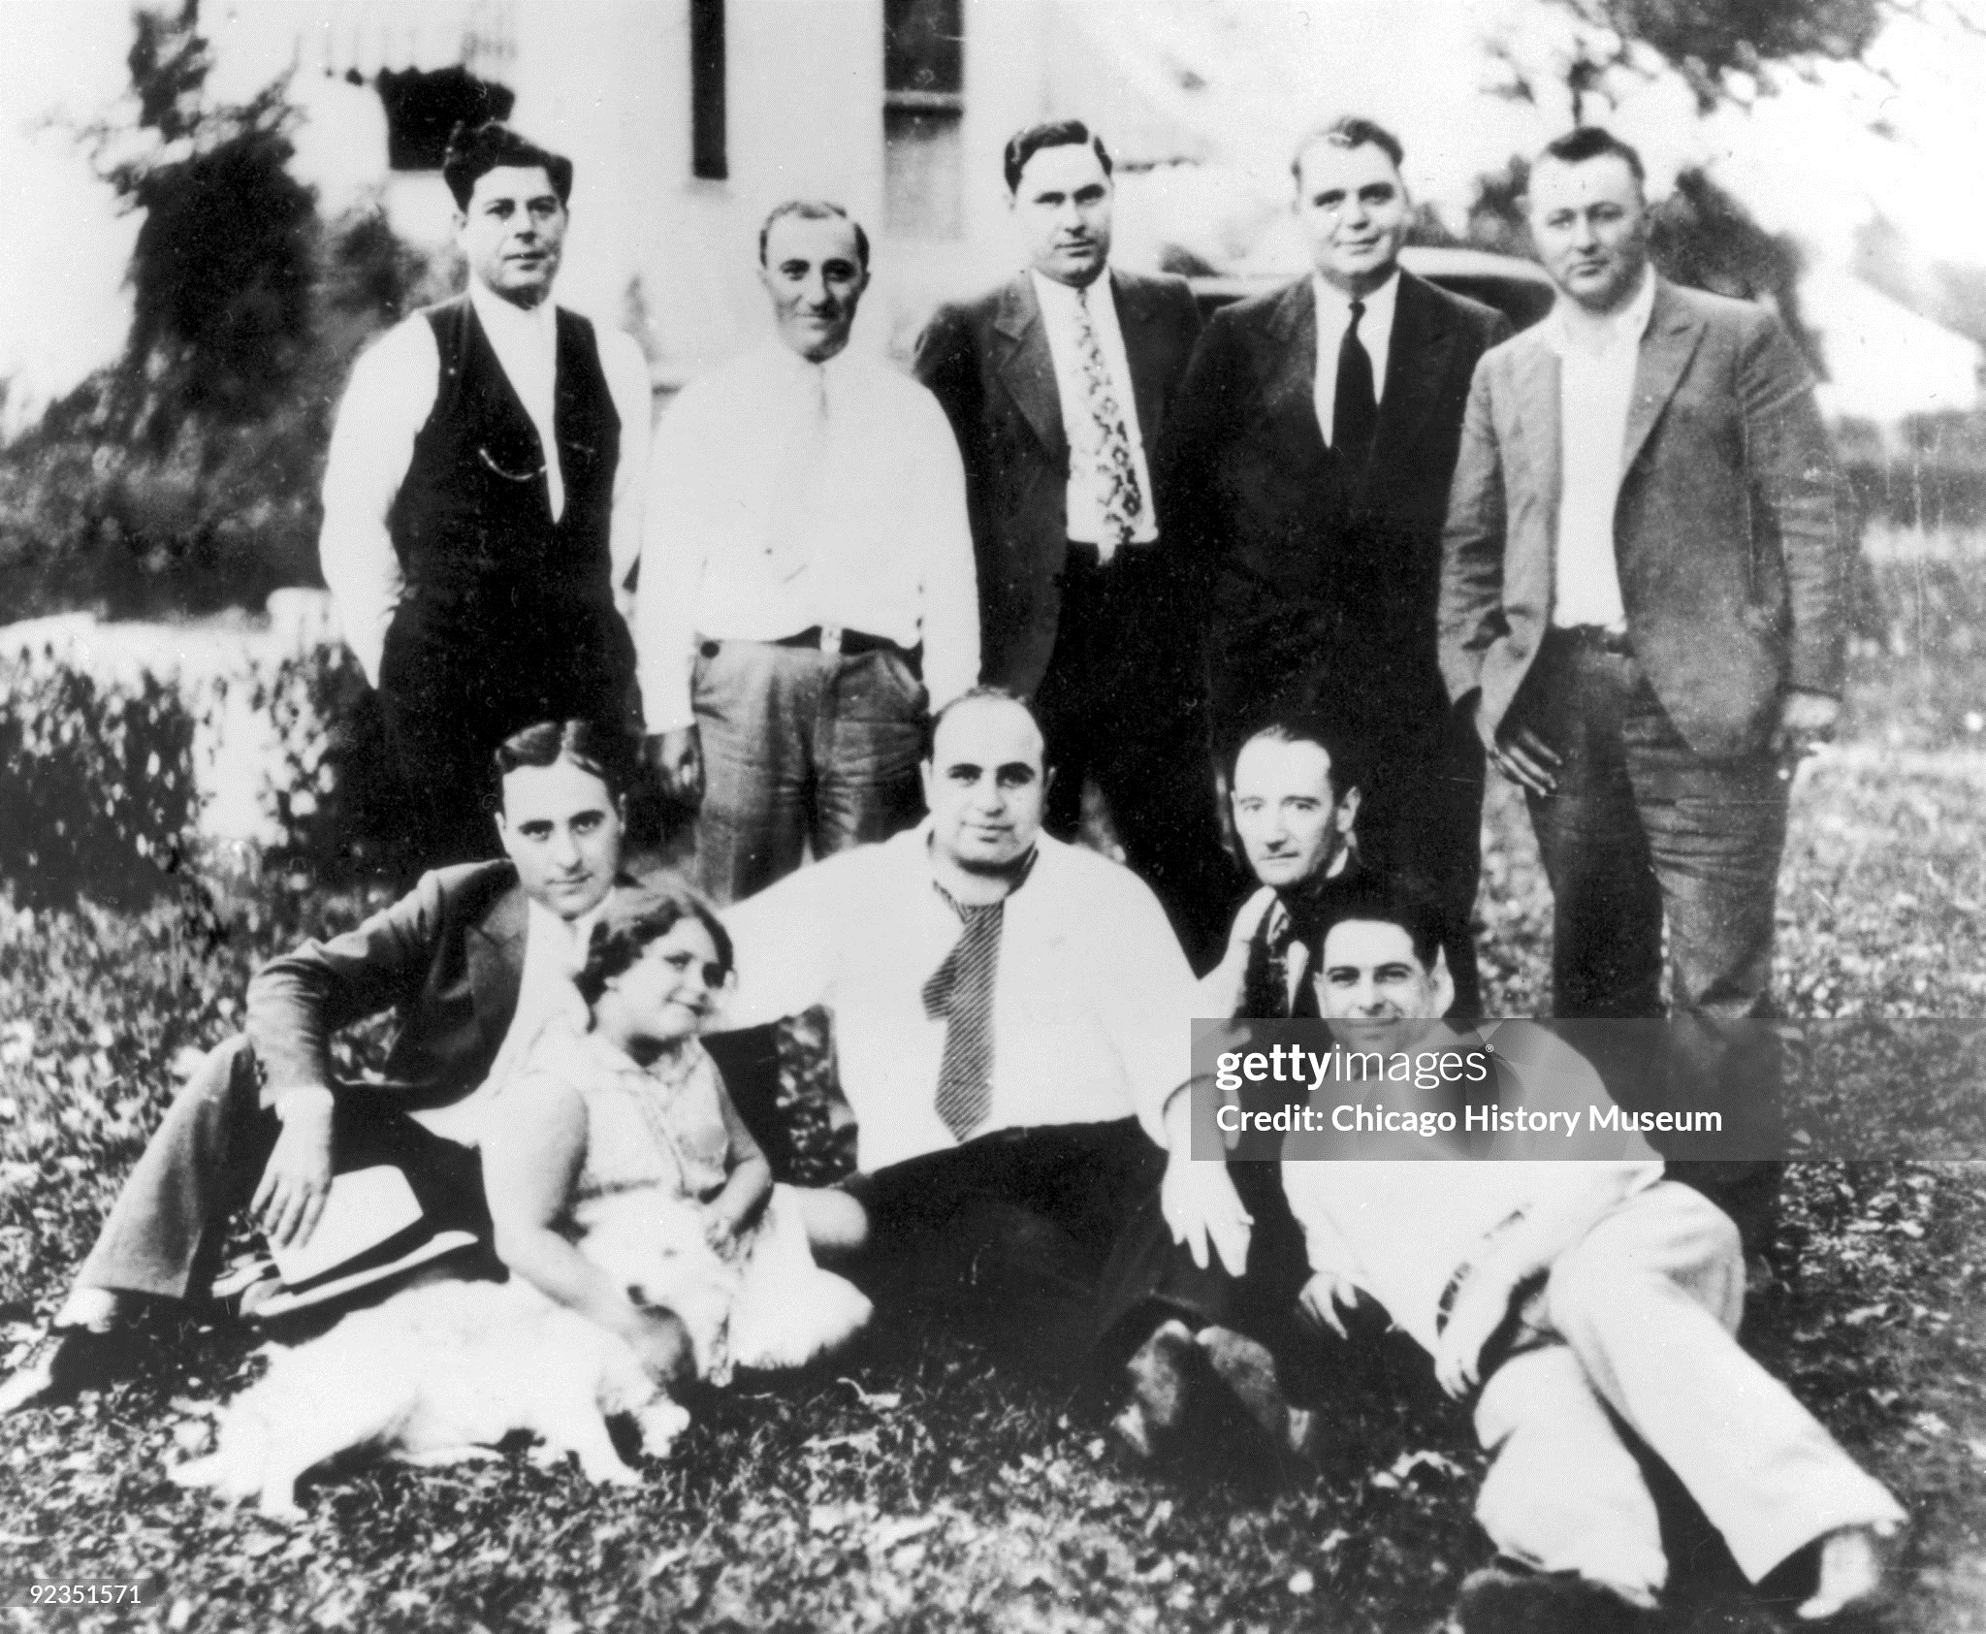
A family man

Slide 15
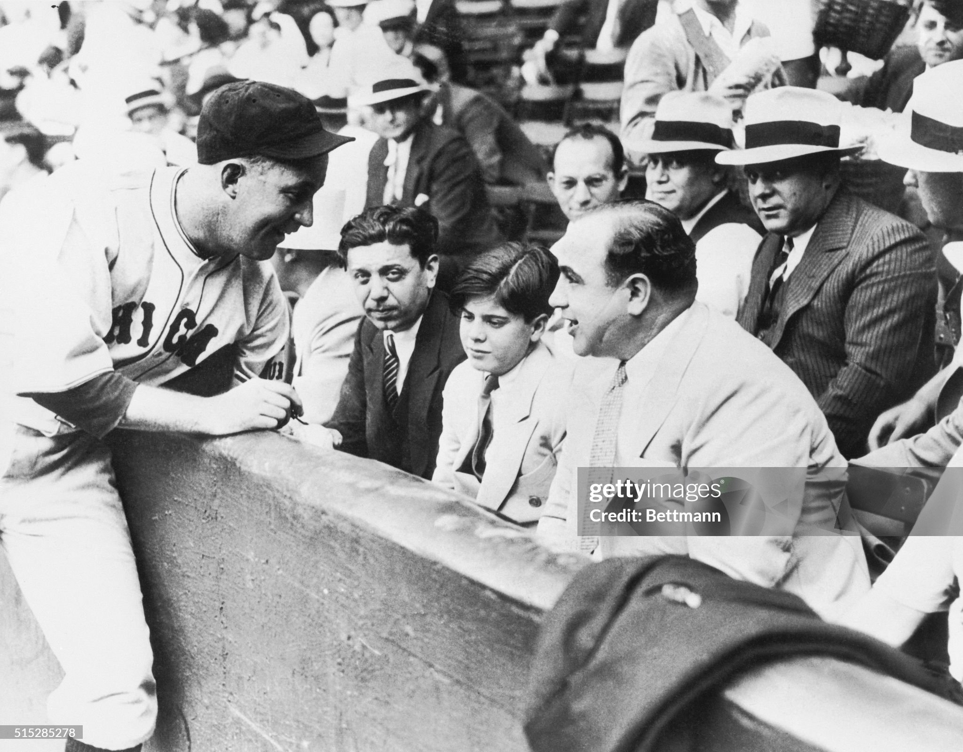
And celebrity…..at World Series Baseball game
There was also a dark side

Slide 16
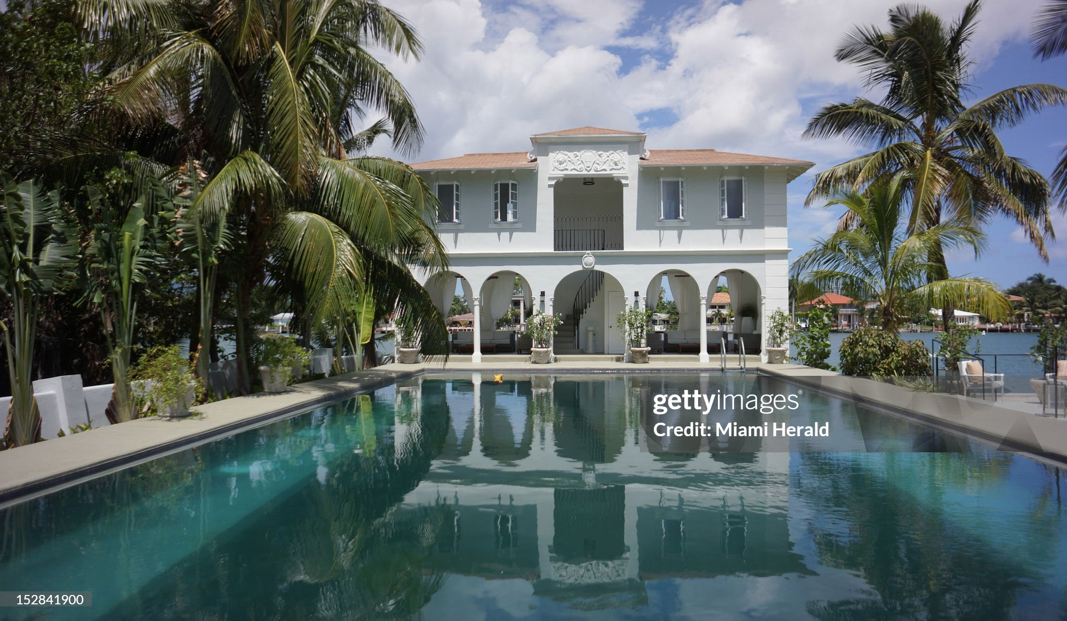
The rewards of crime (Capone’s Florida retreat)

Slide 17
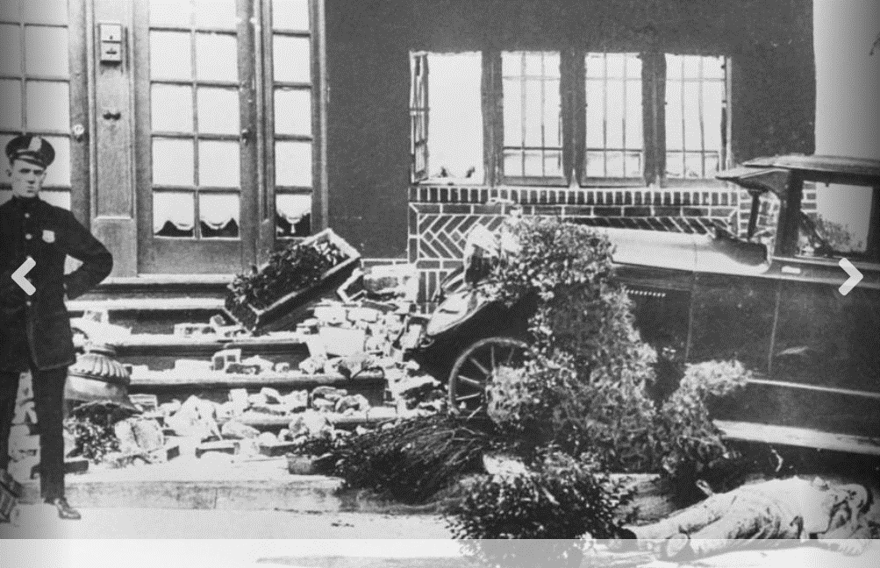
Removal of former boss ..Frankie Vale 1928)

Slide 18
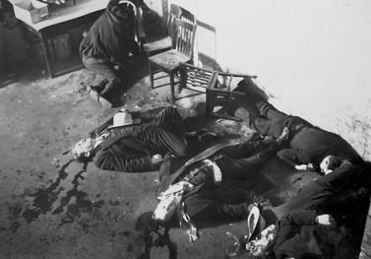
And rivals …the truce meeting that wasn’t…St Valentines Day Massacre 1928

Slide 19
Al Capone quotes
You accomplish more with a smile, a handshake, and a gun than you do with just a smile and a handshake.
I'm a kind person, I'm kind to everyone, but if you are unkind to me, then kindness is not what you'll remember me for
Some call it bootlegging. Some call it racketeering. I call it a business.

Slide 20
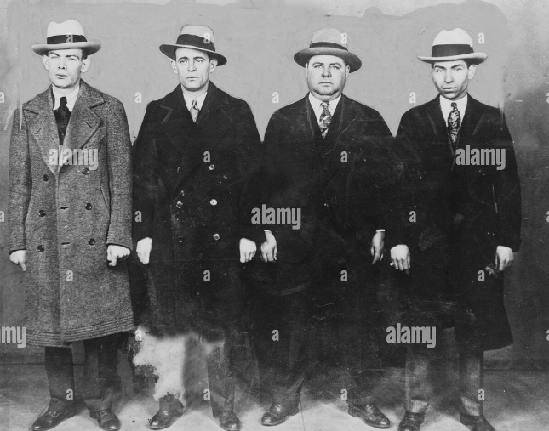
Mobsters …Lucky Luciano. Legs Ed Diamond, Fatty Walsh, …’celebrities” ……..glamorous, lethal, and ruthless

Slide 21
Prohibition and Crime
Homicides per 100,000
 | USA | UK
1900 | 1.2 | 1.0
1920 | 5.0 | 1.3
1930 | 9.0 | 1.2
2023 | 6.0 | 1.1
Some context…Prohibition…..no ‘civilians or families ” killed
During 2023 : .Jamaica …53/100,000, …. Mexico 26/100,000
“Shadow economy” grows to $15n per year, 20% of entire economy
Crime organisations “take over” several city governments (Chicago, Pittsburgh)
…contaminate unions, docks, trucking industries

Slide 22
Meanwhile the economy booms

Slide 23
The Consumer Society …”Buy now pay later” culture emerges
New Media
Radio
Bill boards…..response to cars
Movies
Consumer catalogues
New Financing methods
Ford Weekly payment scheme….abandoned
General Motors Instalment plan….GM lends money to buy car
Introduction of instalment plan financing (Household Finance Corporation
States relax limits on interest charged by credit companies
New phenomena : 75% purchases for durable goods on Instalment plans by 1929…no insurance, unemployment…all okay as long as pay continues

Slide 24
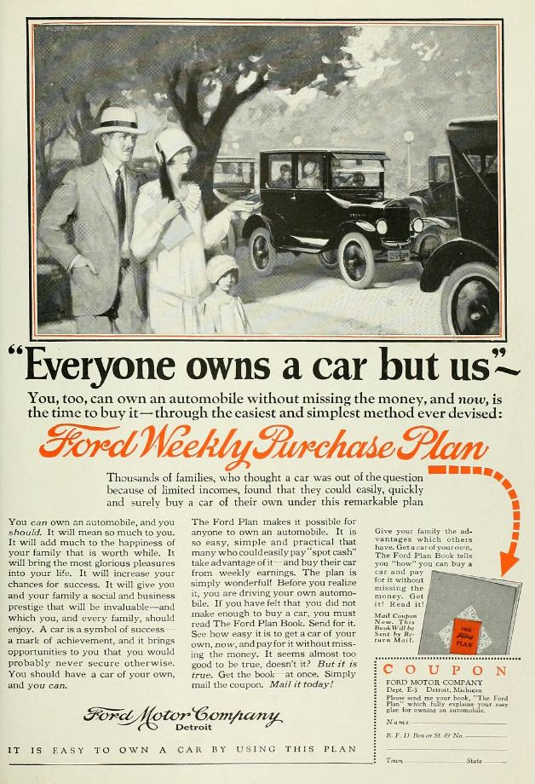
Consumer economy booms

Slide 25
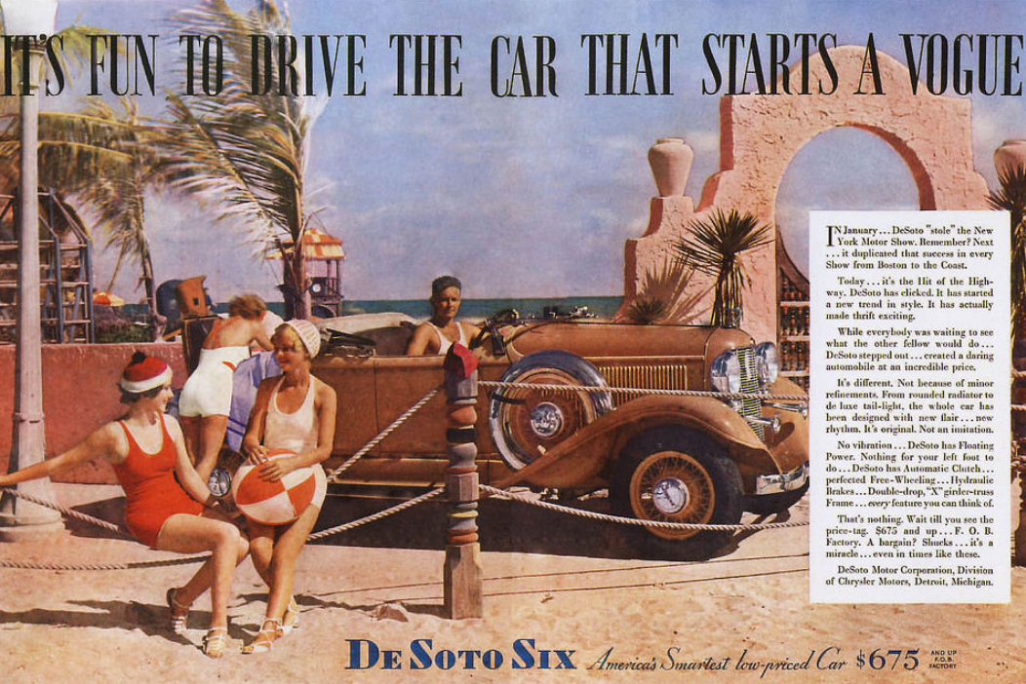

Slide 26
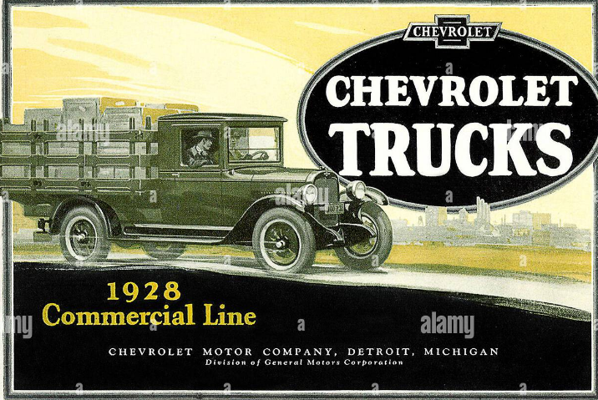

Slide 27
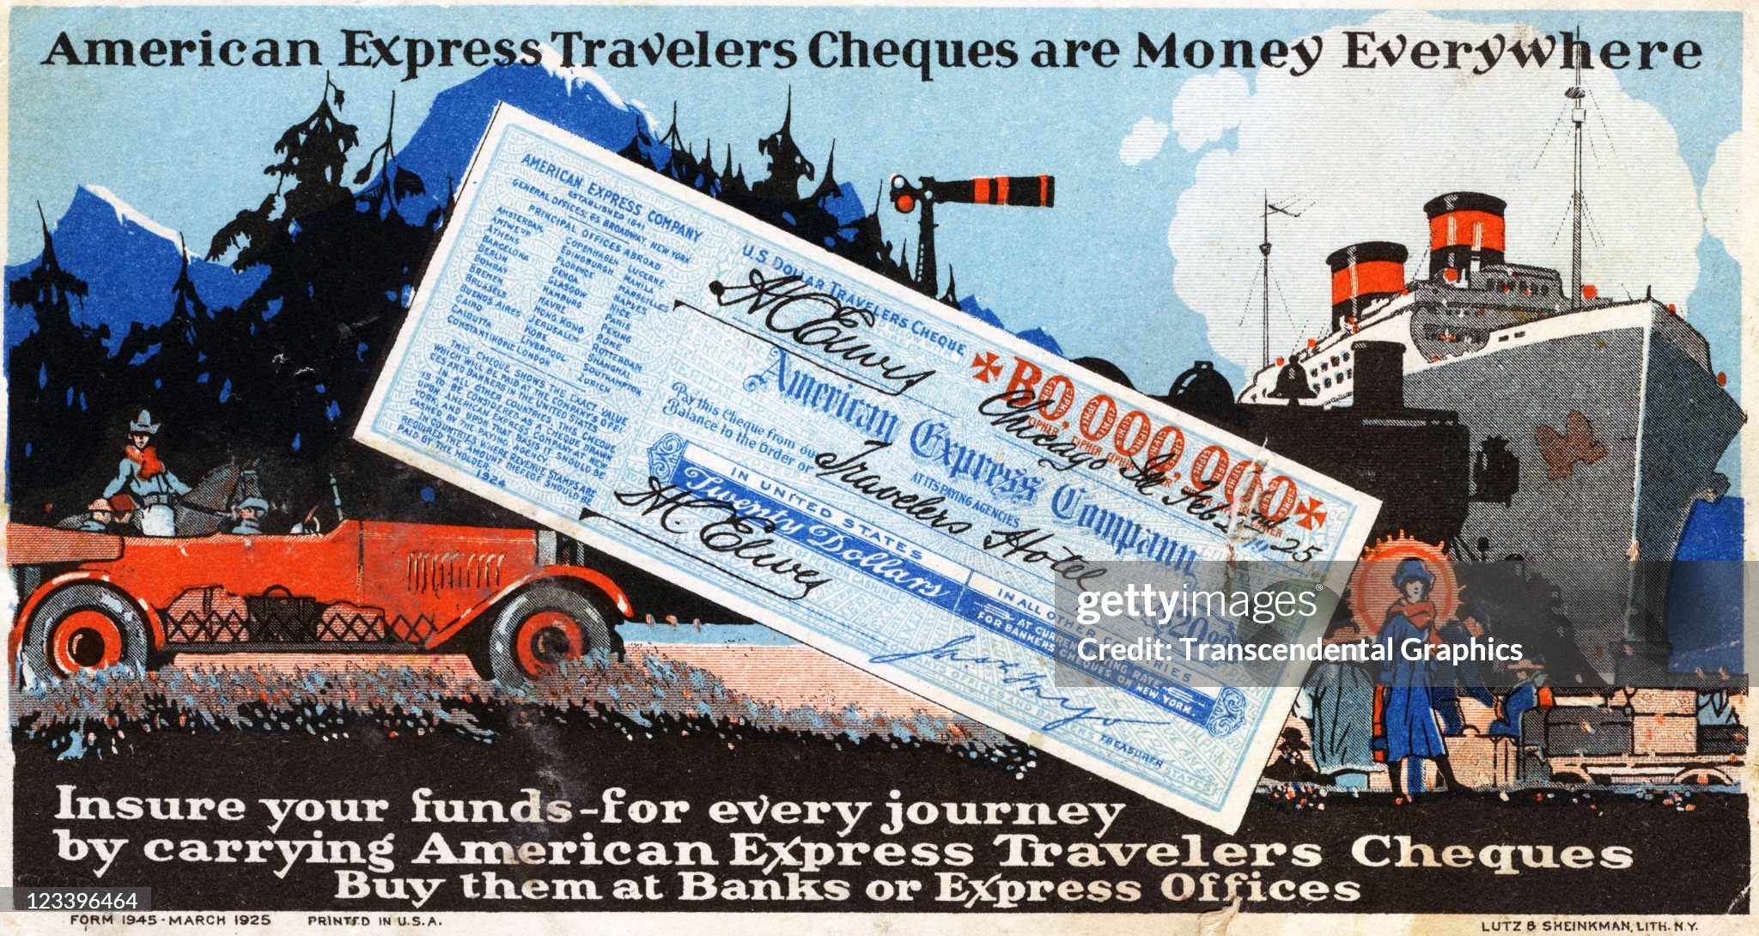
New financial products

Slide 28
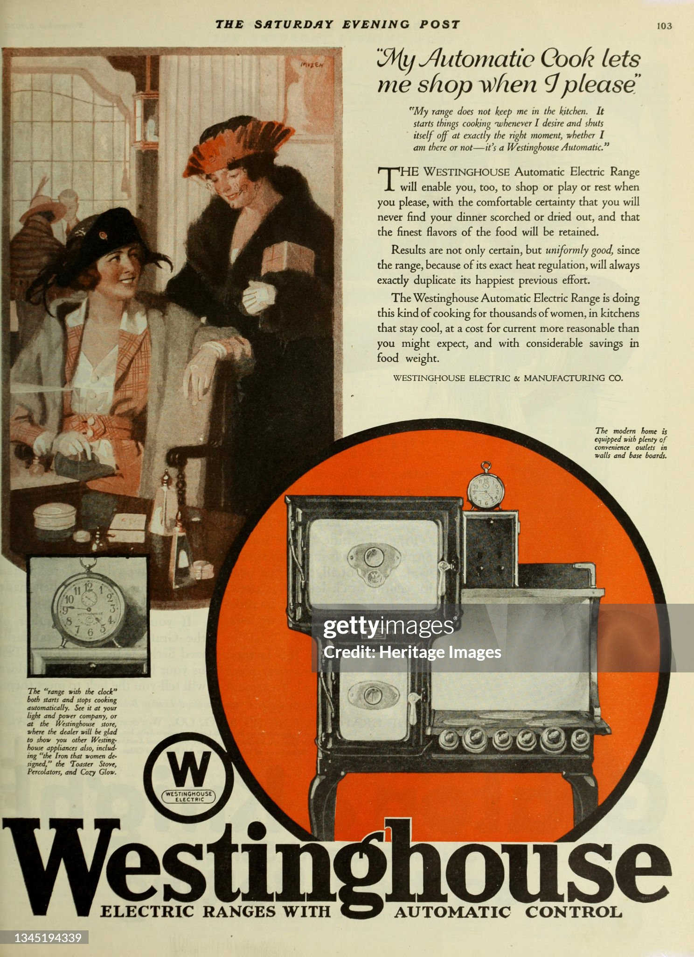

Slide 29
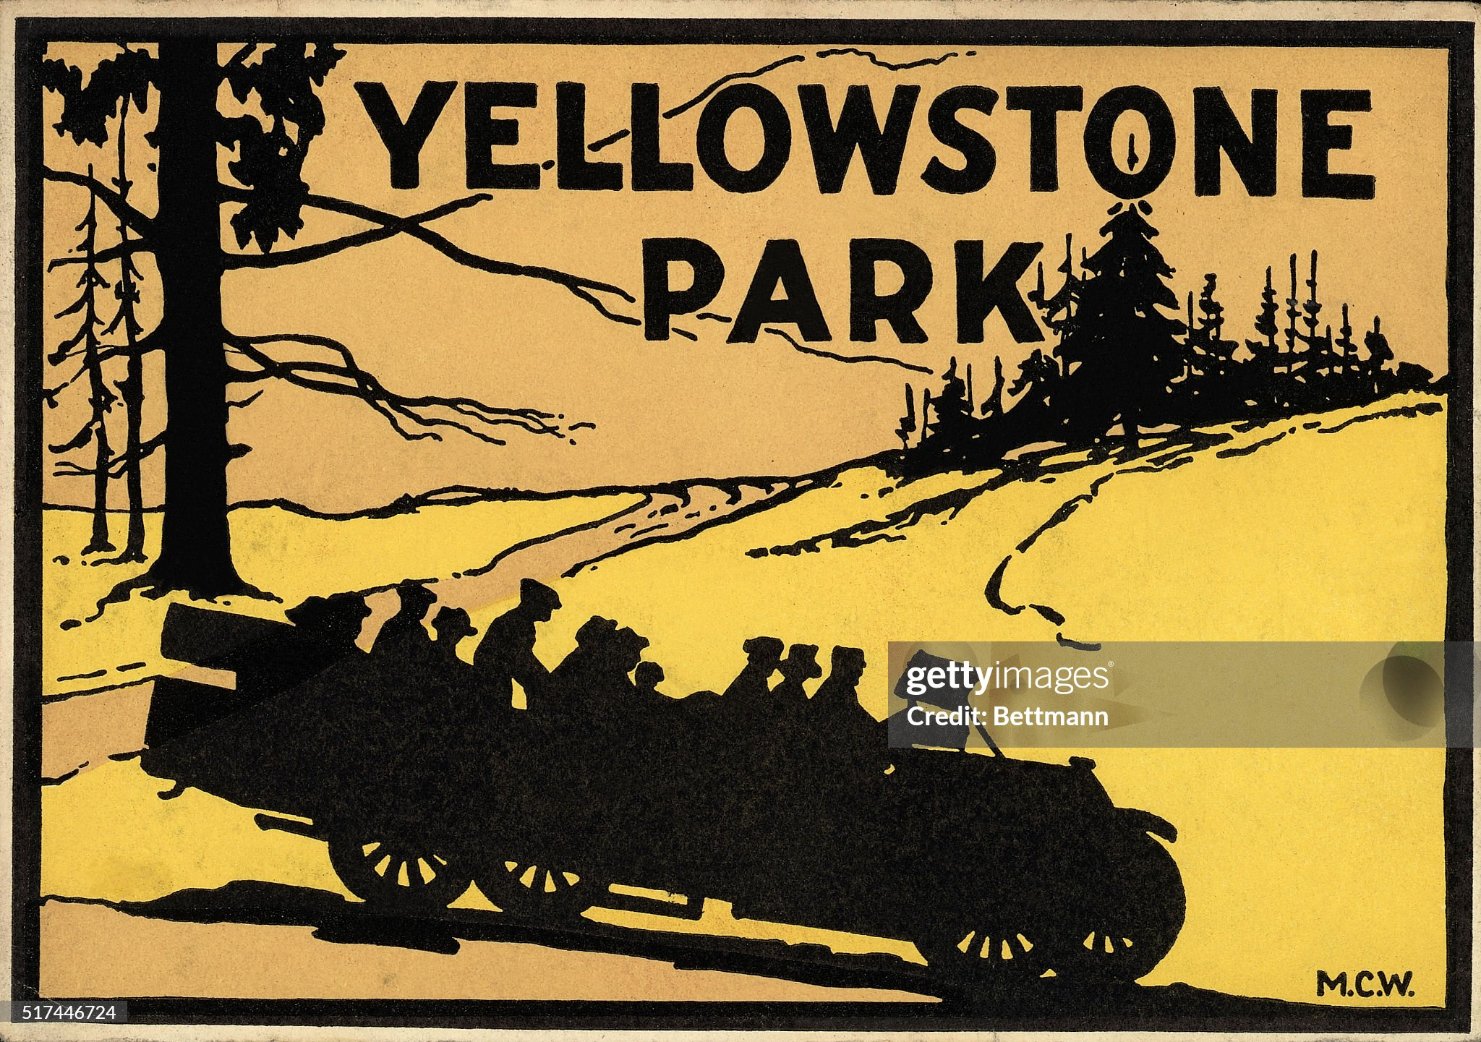

Slide 30
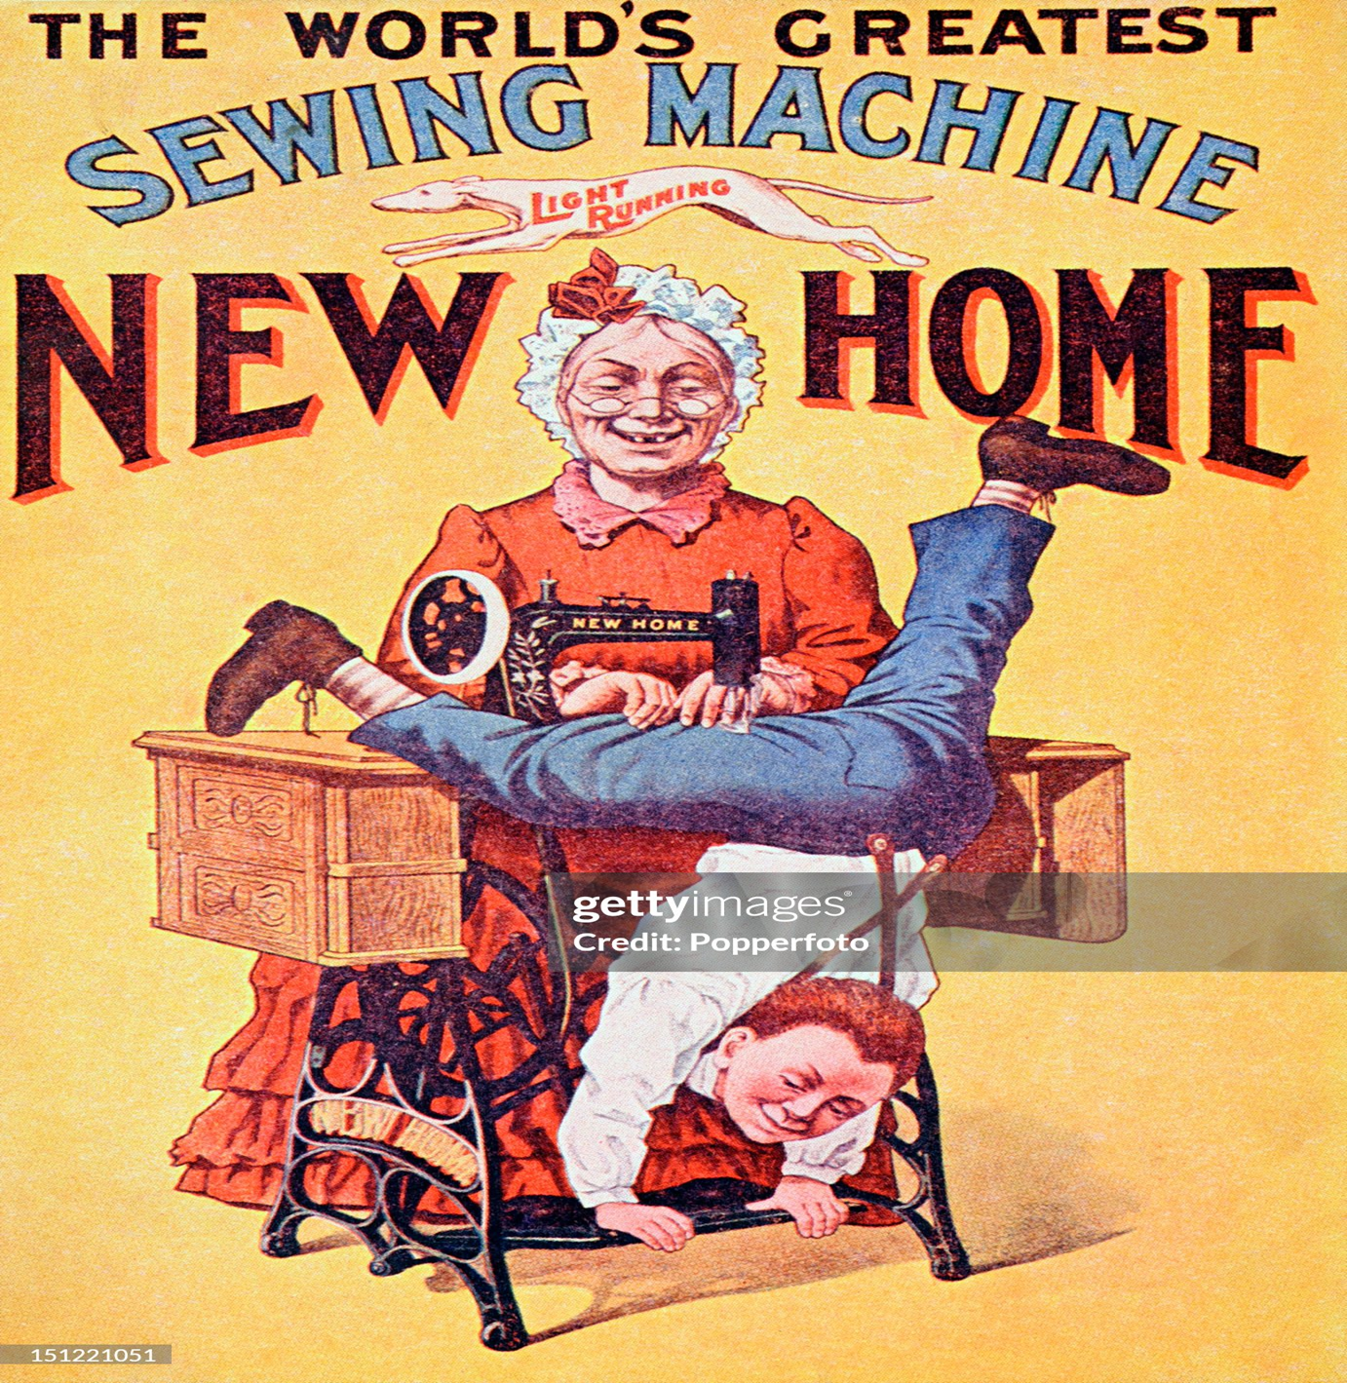

Slide 31
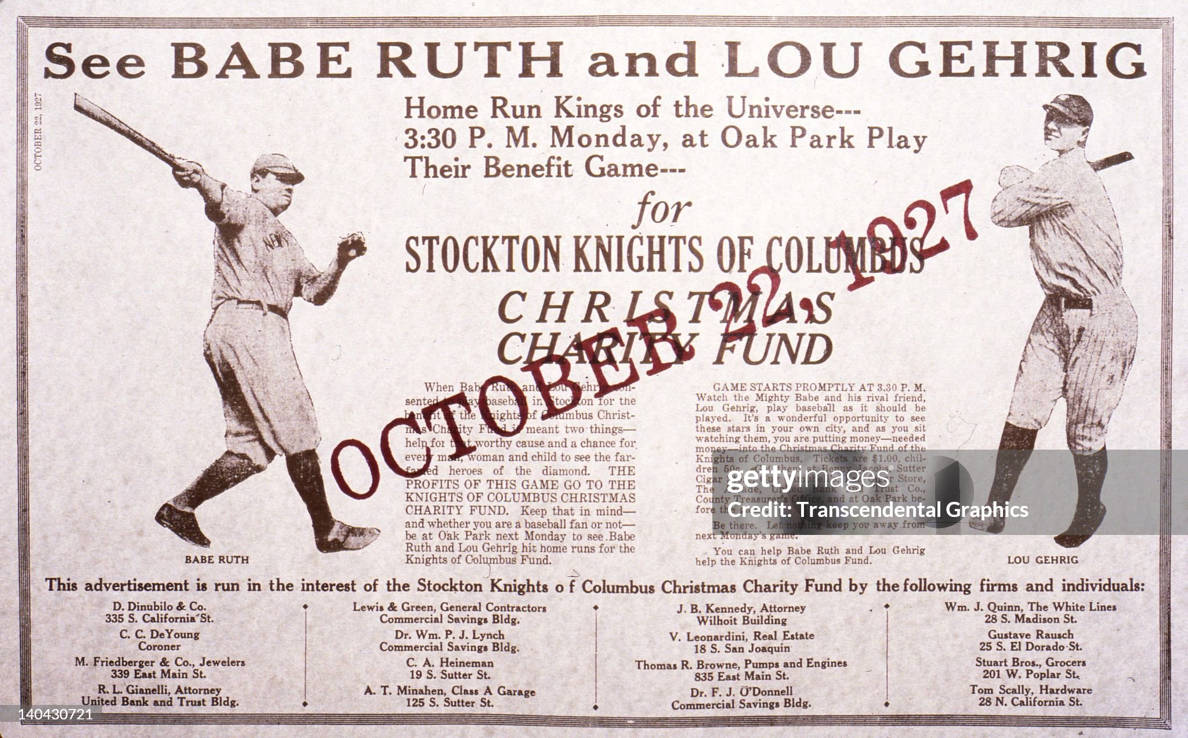
Boom in professional sports

Slide 32
This is a time of heroes

Slide 33
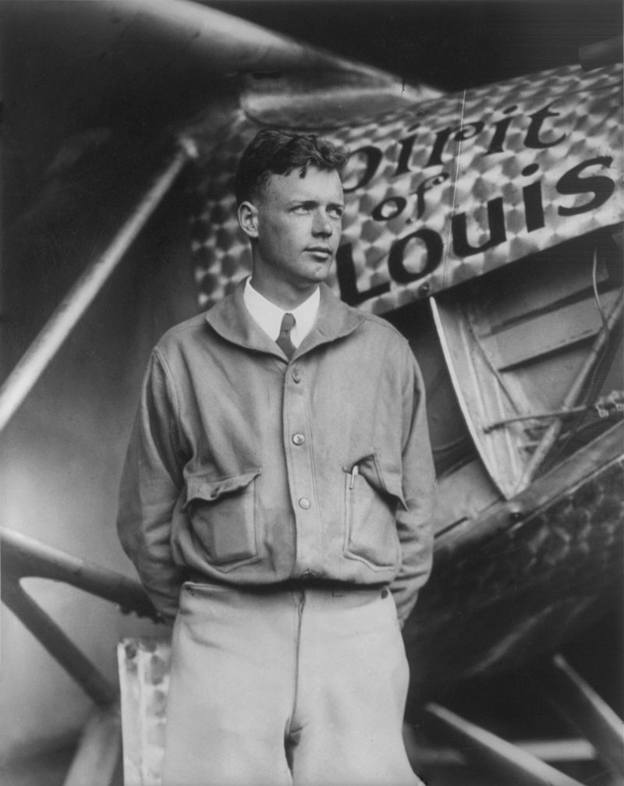
Charles Lindbergh (1902-1974) ….first solo flight across the Atlantic

Slide 34
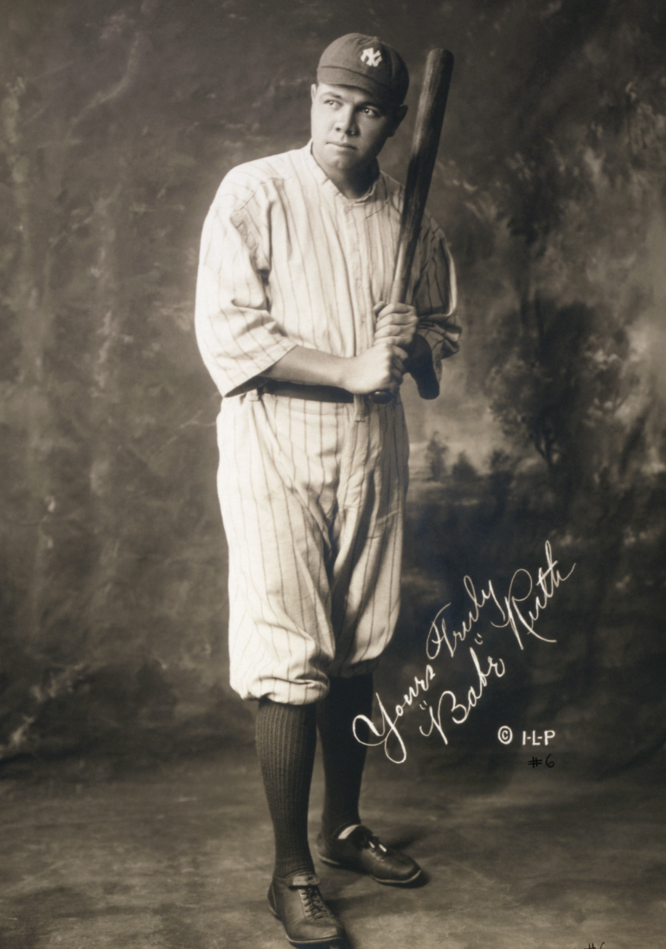
George Herman (Babe) Ruth (1895-1948) …baseball player, superstar & highest paid athlete

Slide 35
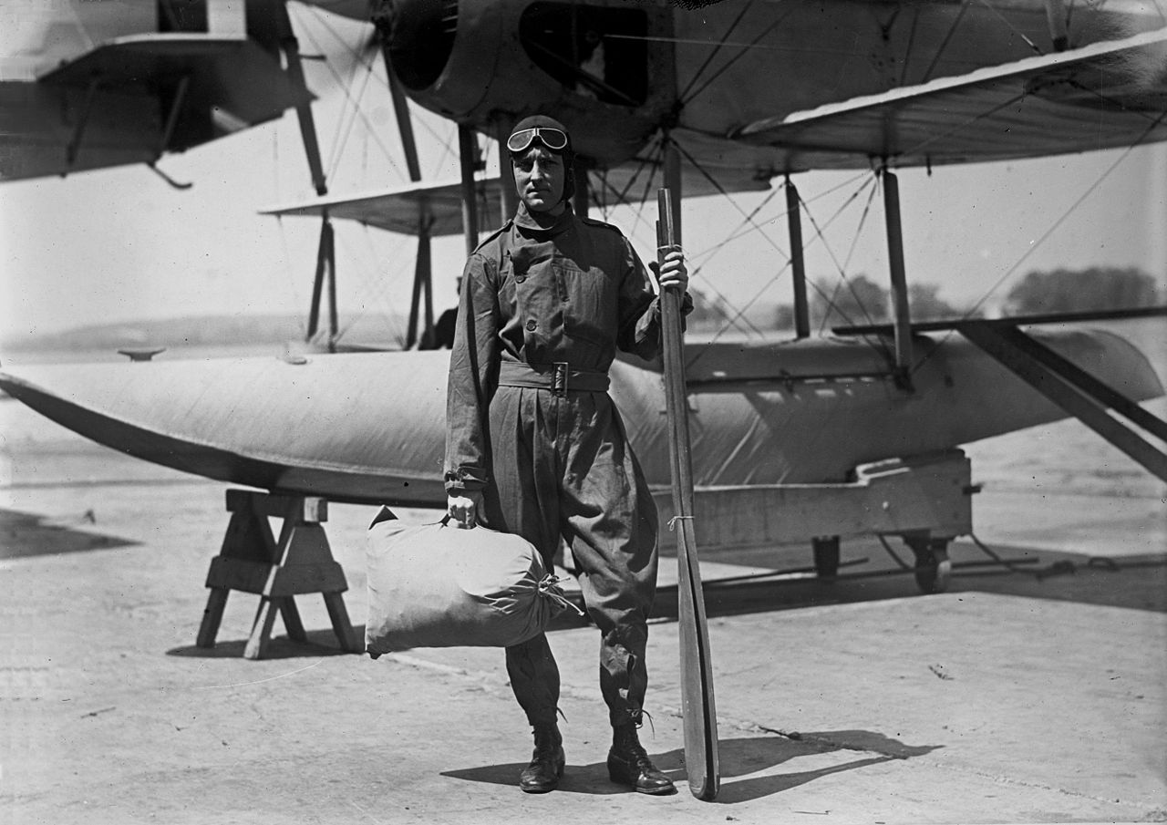
Richard Byrd (1888-1957( …first to fly over north and south poles

Slide 36
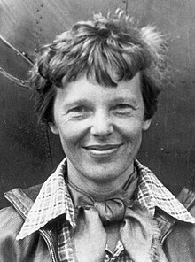
Amelia Earhart (1897-1938?) …first woman to fly across Atlantic

Slide 37
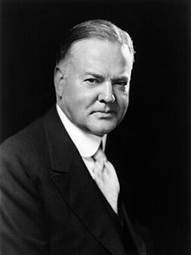
The new President Hoover: all American hero self made man, industrialist, humanitarian.
“Ours is a land rich in resources; stimulating in its glorious beauty; filled with millions of happy homes; blessed with comfort and opportunity. In no nation are the institutions of progress more advanced. In no nation are the fruits of accomplishment more secure. In no nation is the government more worthy of respect. No country is more loved by its people. I have an abiding faith in their capacity, integrity and high purpose. I have no fears for the future of our country. It is bright with hope.”

Slide 38
What could possible go wrong? ….see next talk : Great Depression & New Deal

